Slide 1
Git and Git hub operations
Sandhya Rani

Slide 2
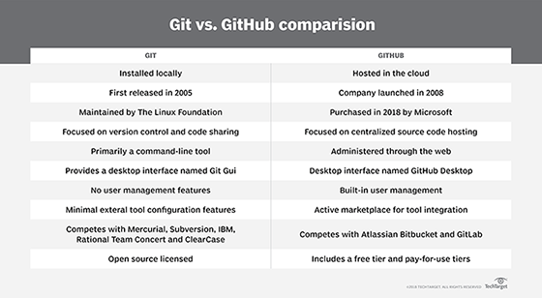
Git vs GitHub

Slide 3
Steps
Step 1: Install git and create a GitHub account
Step 2: Create a new repository on GitHub
Step 3: Open the path in command prompt
Step 4: Git init (check in the folder where new file .git will be created automatically)
Step 5: git add .
Step 6: git commit –m “word related to commit”
Step 7: git status
Step 8: git branch
Step 9: git remote add origin https://github.com/sandhya95500/ustdemo1
Step 10: git push –u origin master

Slide 4
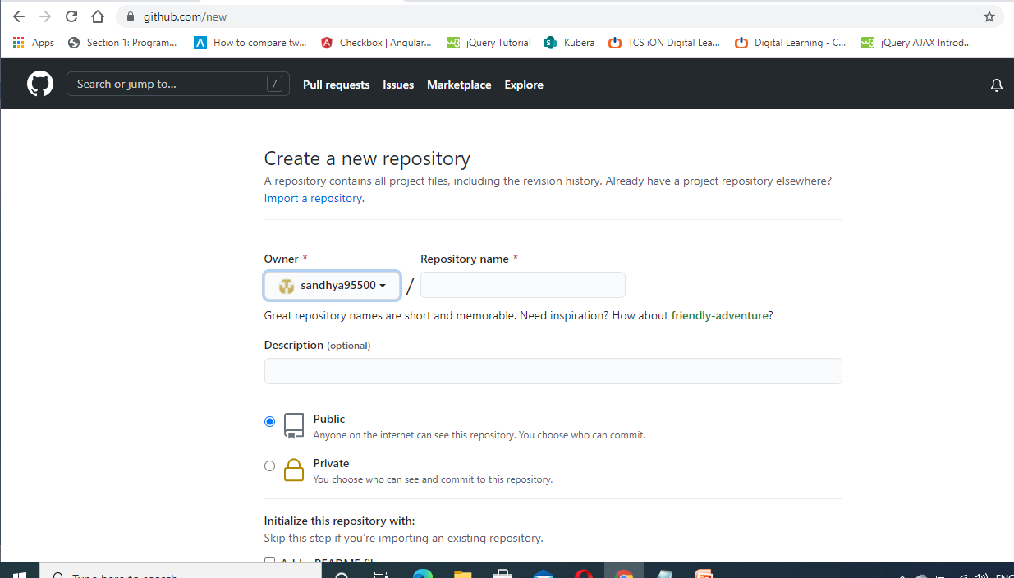
Create a new repository on GitHub

Slide 5
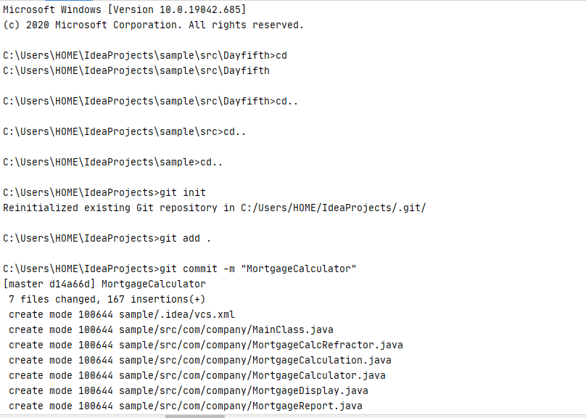
Git hub commands

Slide 6
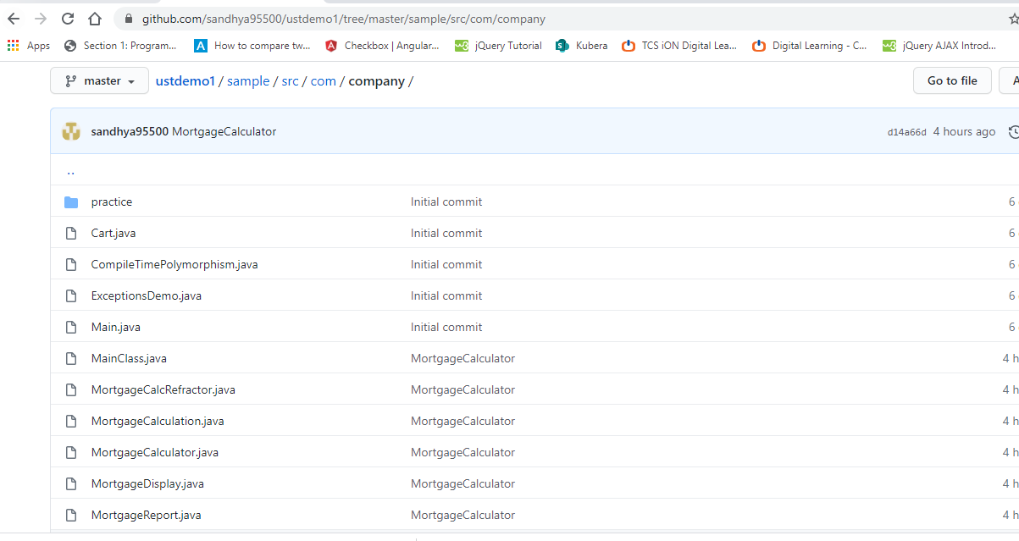
View the files in GitHub

